Slide 1
CPRG 102: .NET Development with MVC
Module 10: Working with Web API

Slide 2
Topic 1 Introduction to Web API

Slide 3
A New Service
“ASP.NET Web API is a new framework expressly designed to support and simplify the building of HTTP services that can be consumed by a variety of clients; in particular, HTML pages and mobile applications.”
(Esposito, 2014)

Slide 4
Introduction
Web API is a lightweight framework for creating web services over HTTP
Addresses the need for an effective way to present services over HTTP
Conforms to REST principles (Representational State Transfer)

Slide 5
History of Web Services
Xml Web Services was the first web service framework offered by Microsoft
Based on open source SOAP protocol and its xml-based messaging system
A part of ASP.NET since its inception
Reliance on xml parsers
WS-* protocols were being developed that had more in-depth specifications than xml
This introduced WCF to the developer community

Slide 6
WCF Services
WCF introduced in.NET Framework 3.0 and built into Visual Studio 2008 onward
Offered a unified programming model
Quickly became the standard for developing web services
Supported multiple transport protocols:
HTTP
TCP
UDP, Message Queueing and others
Supported binary encoding

Slide 7
What are RESTful Services
REST stands for REpresentational State Transfer
The software architectural style of the web
The server and the client don’t know one another
Purely a request/response model
Operates across HTTP only using HTTP verbs
Supports XML and JSON
No support for transactions
HTTP clients include browsers and mobile devices like tablets and smartphones

Slide 8
Benefits of Web API
Less development effort required
No configuration
Uses fewer resources
Better performance due to fewer data conversions required by SOAP-based services
Easier access through HTTP verbs: GET, PUT, DELETE and POST
Testability

Slide 9
Moving to ASP.NET Core MVC
MVC and Web API and Web Pages have merged, now a unified programming model called ASP.NET Core MVC
The two controllers have merged into one common controller that serves both MVC and Web API:
System.Web.Mvc.Controller (MVC)
System.Web.Http.ApiController (Web API)
Microsoft.AspNet.Mvc.Controller (common)

Slide 10
Topic 2 Using Web API Services

Slide 11
Creating the Web API Service
Layered solution has a domain layer and persistence layer
Web API service simply accesses middle layer to handle the CRUD activity required by the application
To create the service layer requires creating a Web API project

Slide 12
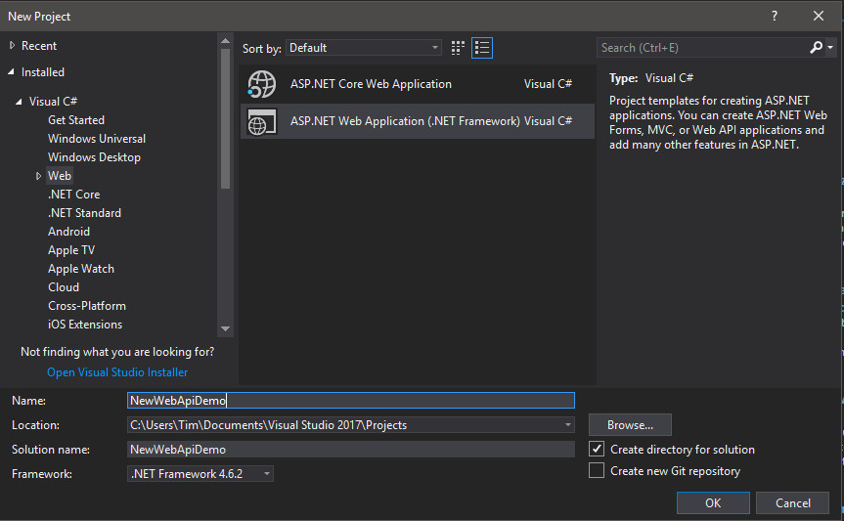
Starting a Web API Project (MVC 5)

Slide 13
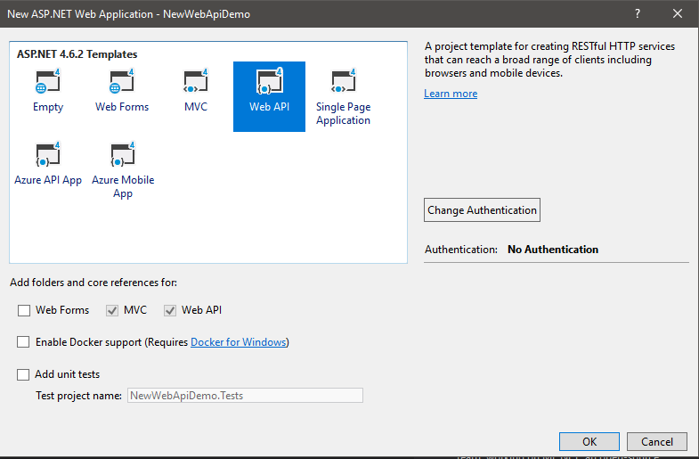
Starting a Web API Project cont’d

Slide 14
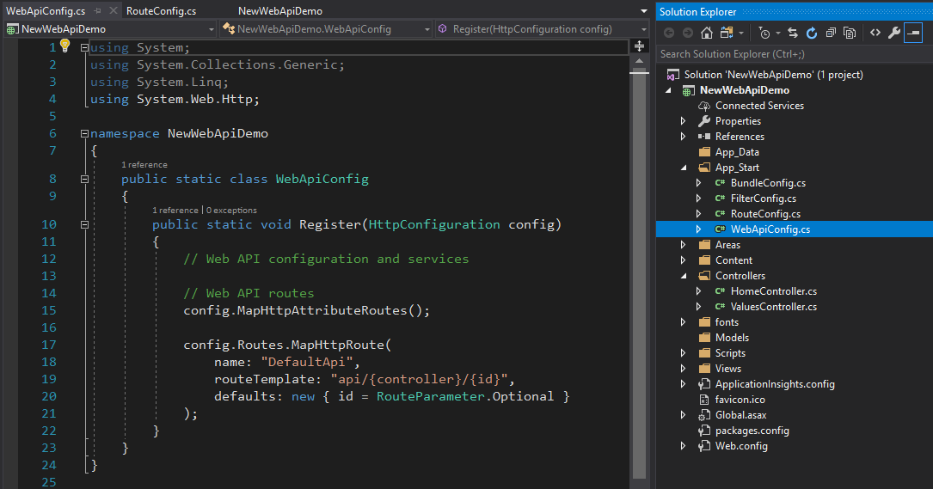
Starting a Web API Project cont’d

Slide 15
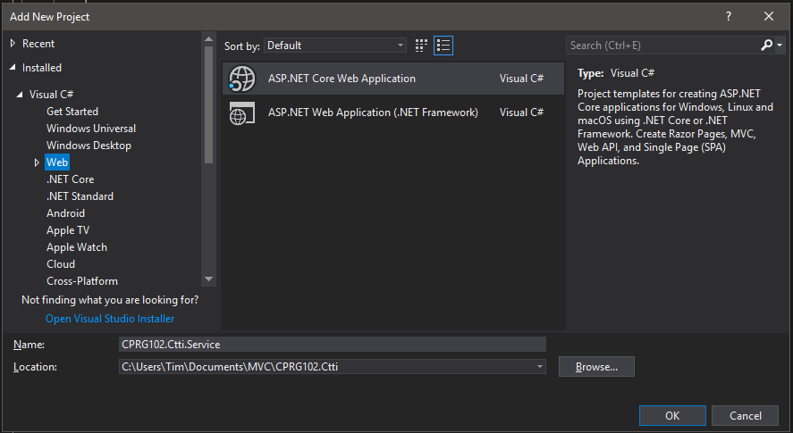
Starting New WebAPI Core Project

Slide 16
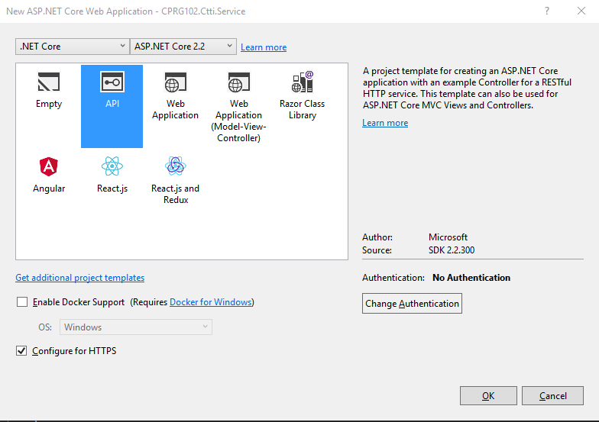
Starting New WebAPI Core Project 2

Slide 17
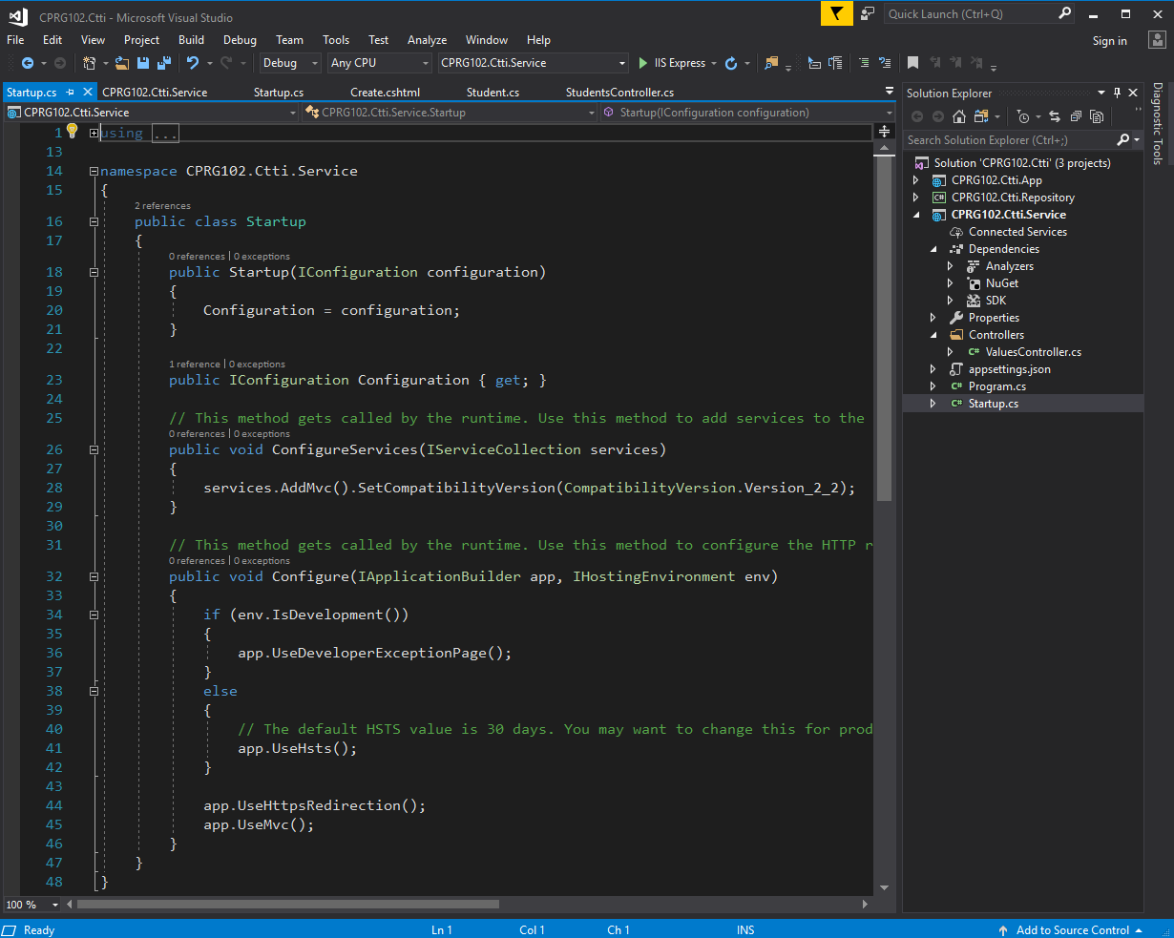
Starting New WebAPI Core Project 3

Slide 18
The Controller Class for Web API
MVC 5 class: ApiController
Namespace: System.Web.Http
No dependency on System.Web or System.Web.Mvc
MVC Core class: Controller
Namespace: Microsoft.AspNetCore.Mvc
Same controller class as MVC Core applications
Class methods return data, not views
HTTP request resolved in terms of the action method (like MVC controllers) using a routing table

Slide 19
Add Controllers
public static void Register(HttpConfiguration config)
{
config.Routes.MapHttpRoute(
name: "DefaultApi",
routeTemplate:"api/{controller}/{id}",
defaults: new { id = RouteParameter.Optional }
);
}
Note the action name is missing from the url route above
Web API framework uses HTTP methods
Web APIs in ASP.NET Core use attribute based routing or configured in Startup class

Slide 20
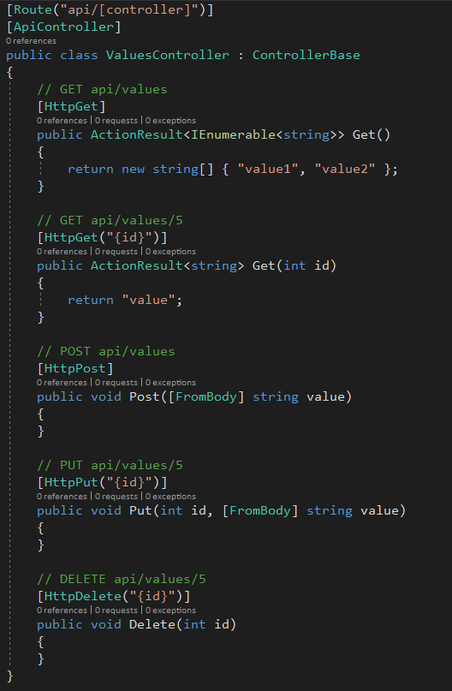
Routing for ASP.NET Core Web API

Slide 21
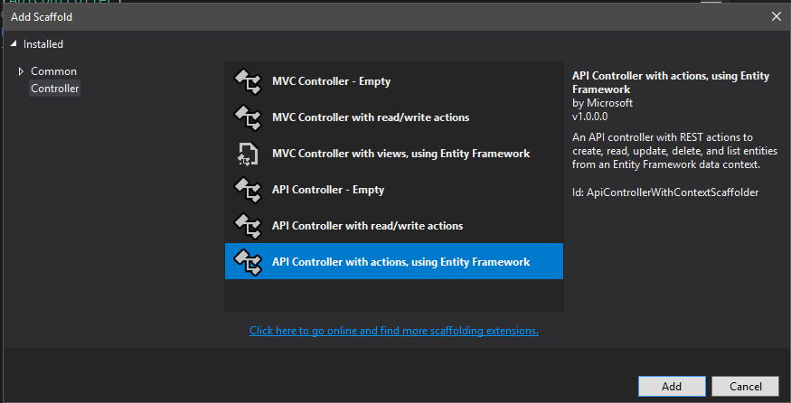
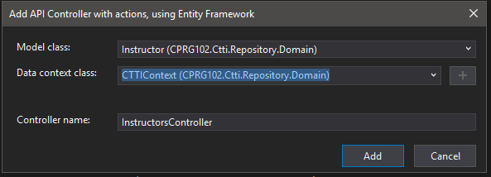
Adding a Controller (MVC Core)

Slide 22
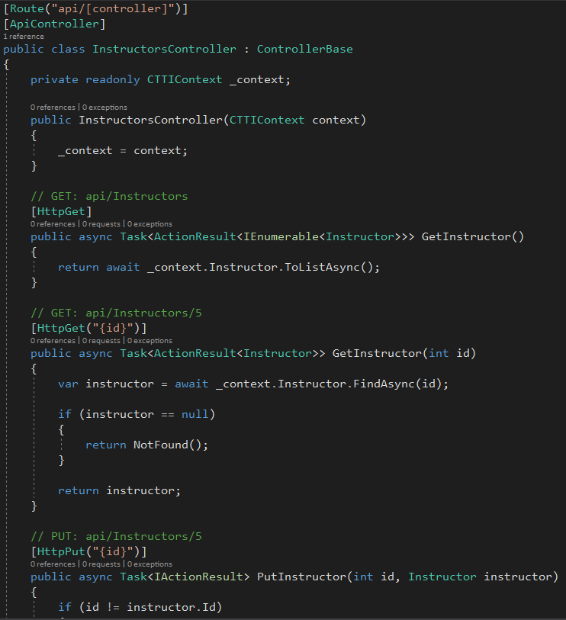
Adding a Controller 2 (MVC Core)

Slide 23
Web API Routing Convention
Client call may look like this:
http://server/api/instructor/12
Web API looks for HTTP method that matches request
HTTP GET looks for a method name starting with Get. If more than one, uses the one that matches closest to the URL route – one with an integer passed into the Get method
GET returns something: a scalar value, an object or a collection

Slide 24
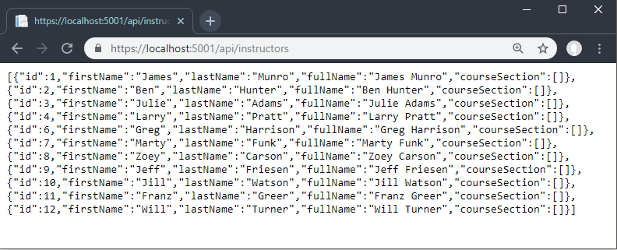
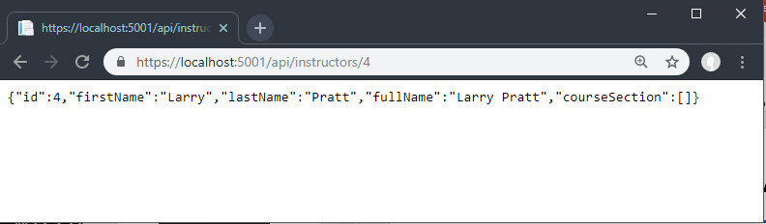
Calling a Web API Method

Slide 25
POST Methods (MVC Core)
Method returns an ActionResult found in Microsoft.AspNetCore.Mvc namespace:
// POST: api/Instructors
[HttpPost]
public async Task<ActionResult<Instructor>> PostInstructor(Instructor instructor)
{
_context.Instructor.Add(instructor);
await _context.SaveChangesAsync();
return CreatedAtAction("GetInstructor",
new { id = instructor.Id }, instructor);
}

Slide 26
PUT Methods (MVC Core)
PUT methods usually update an existing entity in the application:
// PUT: api/Instructors/5
HttpPut("{id}")]
public async Task<IActionResult> PutInstructor(int id, Instructor instructor)
{
if (id != instructor.Id)
{
return BadRequest();
}
_context.Entry(instructor).State = EntityState.Modified;
await _context.SaveChangesAsync();
return NoContent();
}

Slide 27
GET Methods (MVC Core)
PUT methods usually update an existing entity in the application:
// GET: api/Instructors
[HttpGet]
public async Task<ActionResult<IEnumerable<Instructor>>> GetInstructor()
{
return await _context.Instructor.ToListAsync();
}

Slide 28
DELETE Methods (MVC Core)
DELETE methods are expected to delete an existing entity in the application:
// DELETE: api/Instructors/5
[HttpDelete("{id}")]
public async Task<ActionResult<Instructor>> DeleteInstructor(int id)
{
var instructor = await _context.Instructor.FindAsync(id);
if (instructor == null)
return NotFound();
_context.Instructor.Remove(instructor);
await _context.SaveChangesAsync();
return instructor;
}

Slide 29
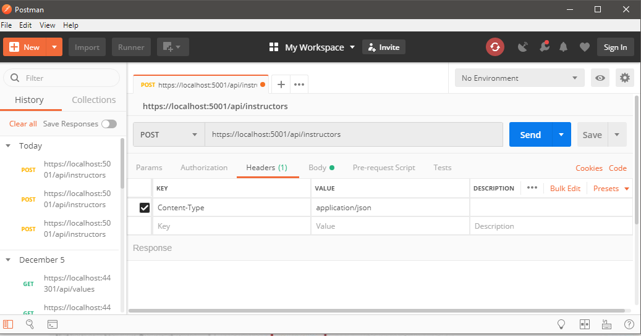
Postman – A Web API Testing Tool
Start with a Post and enter the api url
Set the Content-Type header to application/json

Slide 30
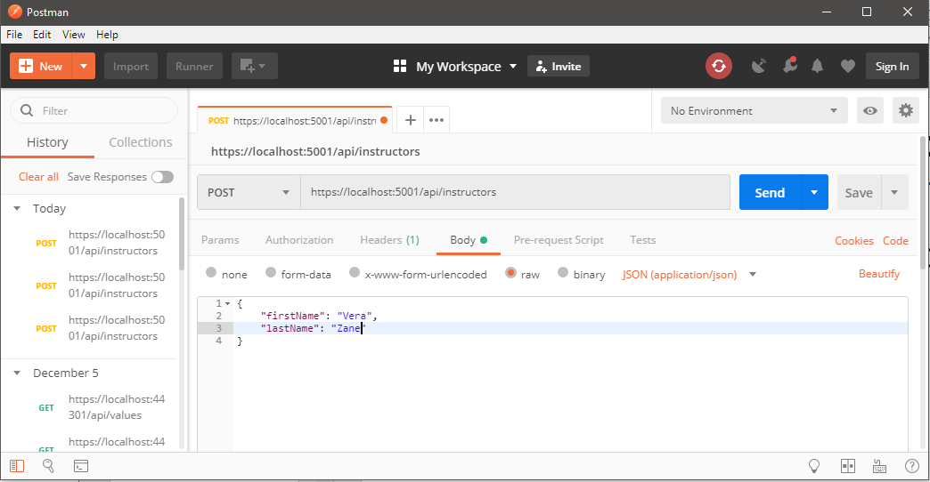
Postman – A Web API Testing Tool
Set the body with raw json object
Click Send

Slide 31
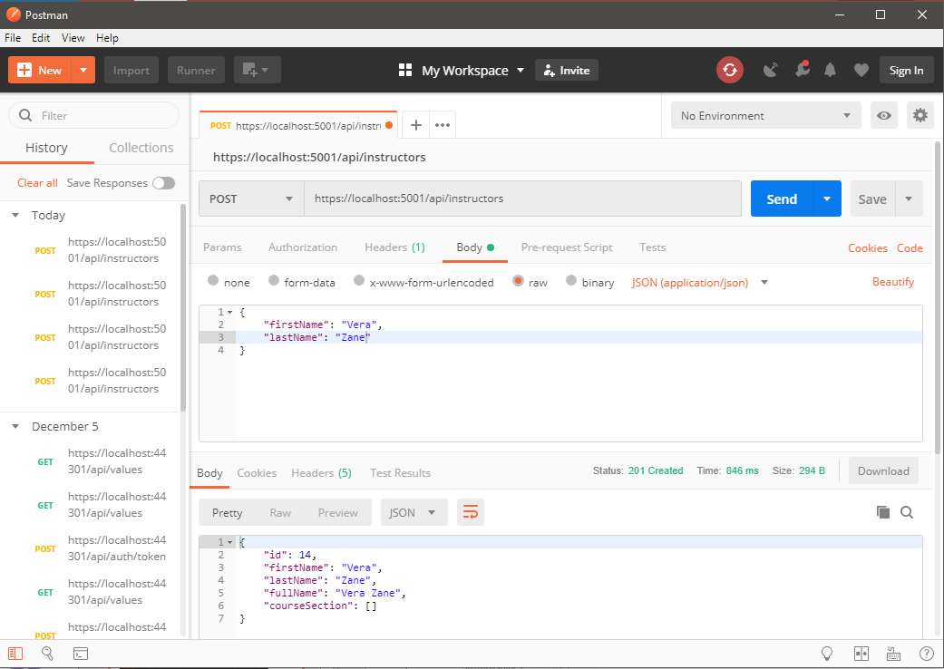
Postman – A Web API Testing Tool
The result returned includes the created object (see id value) and the 201 Created status code

Slide 32
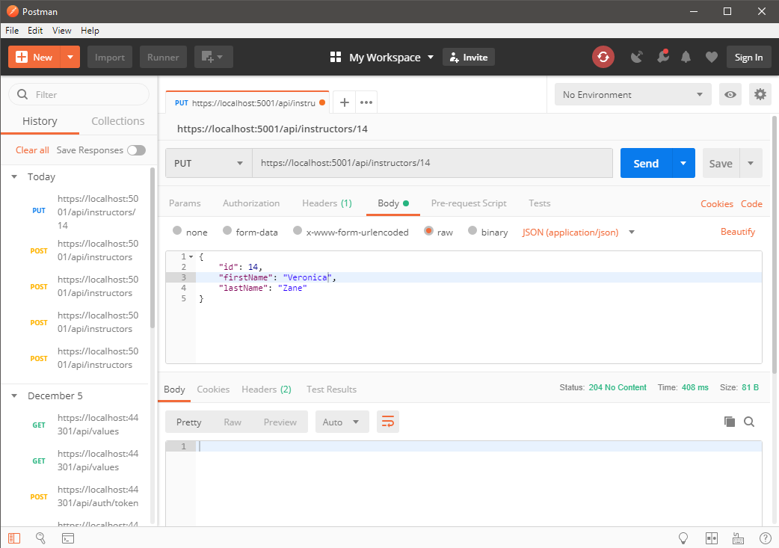
Postman – A Web API Testing Tool
Send a Put with the id in the url and in the body
A 204 No Content status code returned

Slide 33
Topic 3 Creating a Web API Client

Slide 34
A C# Client – Posting Data
//Code in the create action method of the Instructors controller
using (HttpClient client = new HttpClient())
{
instructor.Id = "0";
client.BaseAddress = new Uri("https://localhost:5001");
string stringData = JsonConvert.SerializeObject(instructor);
var contentData = new StringContent(stringData,
System.Text.Encoding.UTF8,
"application/json");
HttpResponseMessage response =
client.PostAsync("/api/instructors/create", contentData)
.Result;
var status = response.StatusCode; //should be 201
ViewBag.Message = response.Content.ReadAsStringAsync().Result;
return Redirect("Index");
}

Slide 35
A C# Client - Getting Data
//variables in the Instructors controller class:
HttpClient Client;
string URL = "https://localhost:5001/api/instructors";
//constructor code:
Client = new HttpClient();
Client.BaseAddress = new Uri(URL);
Client.DefaultRequestHeaders.Accept.Clear();
Client.DefaultRequestHeaders.Accept.Add
(new MediaTypeWithQualityHeaderValue("application/json"));
//Index action method:
HttpResponseMessage msg = await Client.GetAsync(URL);
if (msg.IsSuccessStatusCode) {
var data = msg.Content.ReadAsStringAsync().Result;
var instructors = JsonConvert.
DeserializeObject<List<Instructor>>(data);
return View(instructors); }
return View("Error");

Slide 36
A Javascript Client
//variables in the Instructors controller class:
var url = "https://localhost:5001/api/Instructors/
$.ajax({
dataType: "json",
url: url
}).success(function (data) {
//do something with data
});

Slide 37
Topic 4 Create an SPA with Web API

Slide 38
What are Single-Page Applications?
Traditional web development required many pages to be created
Some pages were created simply to process the form input or to redirect the user to another page
In an SPA, a page is loaded that handles multiple functionality where only portions of the page need to be loaded or refreshed
The full page does not need to be loaded again
Requires extensive use of JavaScript and AJAX calls to return data, not markup

Slide 39
Benefits of SPAs
Applications more responsive
Reduced page reloading and re-rendering
All UI interaction is on client side
Once page loads, server is just a service layer responding to RESTful HTTP requests
Therefore, SPAs work well with Web API

Slide 40
Demonstrations
In the demonstrations for this module, you will see:
How a Web API service is created and called from a client
How CRUD is managed in a RESTful way
How a single-page application can use a Web API service

Slide 41
Resources
Esposito, D. (2014). Programming Microsoft ASP.NET MVC (3rd ed.). Sebastopol, California: O’Reilly Media.
https://docs.microsoft.com/en-us/aspnet/core/web-api/?view=aspnetcore-2.1
https://docs.microsoft.com/en-us/aspnet/web-api/

Slide 42
© 2017, Southern Alberta Institute of Technology. All rights reserved.
This publication and materials herein are protected by applicable intellectual property laws. Unauthorized reproduction and distribution of this publication in whole or part is prohibited.
For more information, contact:
Director, Centre for Instructional Technology and Development
Southern Alberta Institute of Technology
1301 16 Ave. N.W., Calgary, AB T2M 0L4

